Slide 1
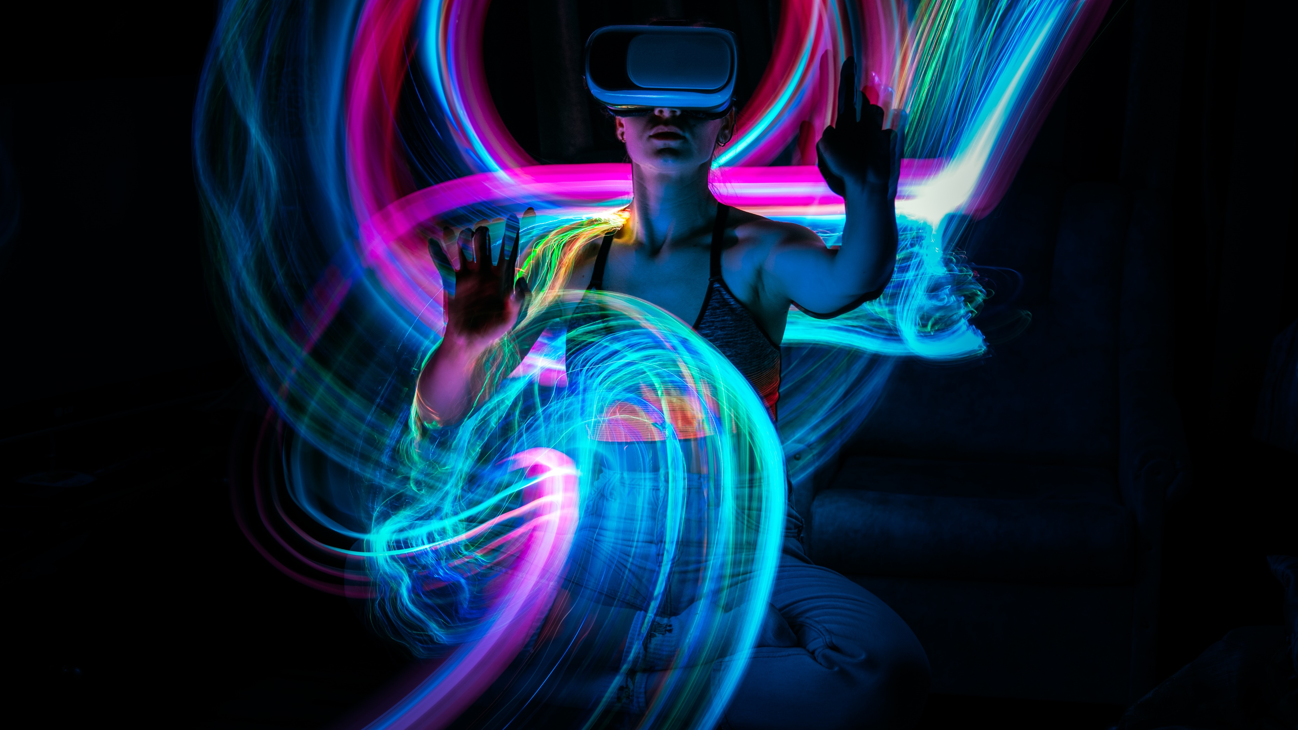
METAVERSE.

Slide 2
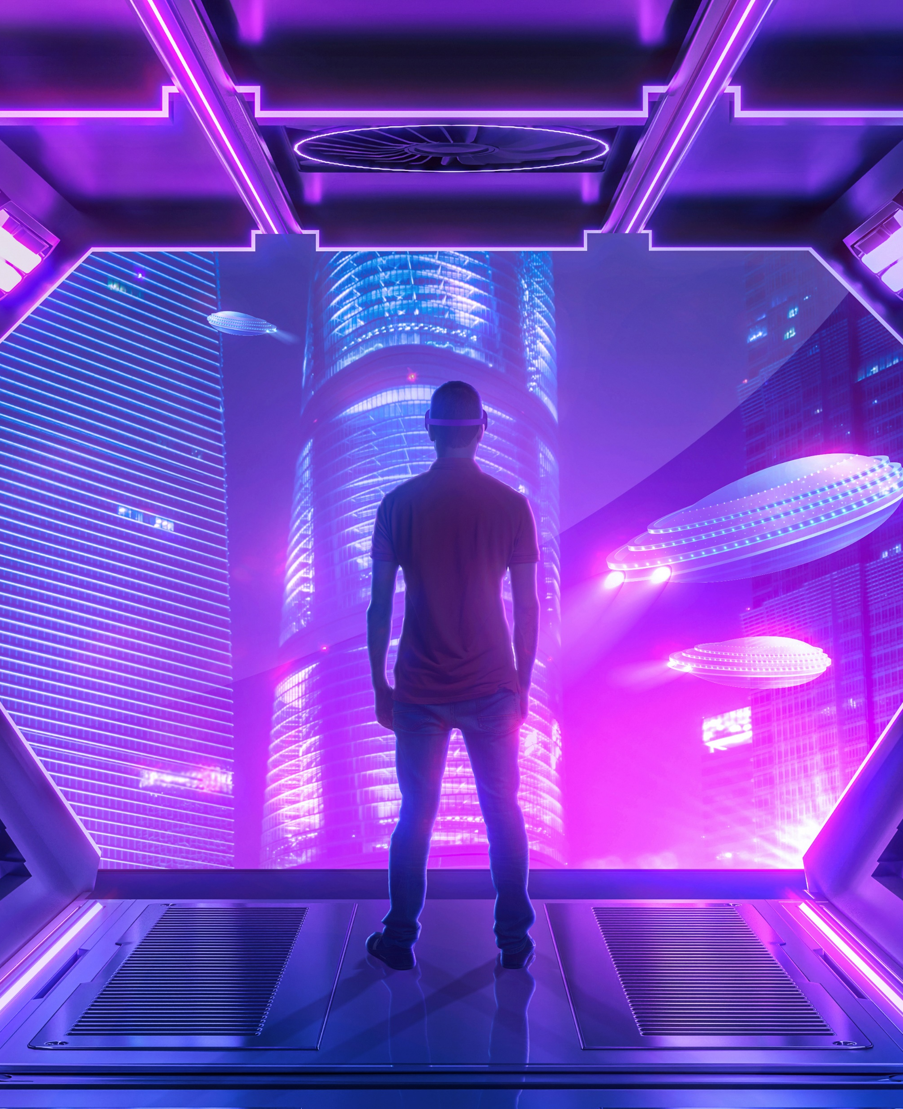
Welcome To The World Of Metaverse
It is very important to know the history of Metaverse
Today we describe the Metaverse as a fully immersive internet, where we will be able to access augmented and virtual reality and interact with all sorts of environments using persistent avatars and innovative digital technology.
The thing is: The metaverse is not new!
Let’s look at some of the key historical milestones that have led to where we are today as we develop cutting-edge Web 3.0 technology.

Slide 3

History Of Metaverse
It all started back in 1838 when scientist Sir Charles Wheatstone outlined the concept of "binocular vision," where you combine two images — one for each eye — to make a single 3D image.
This concept led to the development of stereoscopes, a technology where you use the illusion of depth to create an image. This is the same concept used today in modern VR headsets.
Now we jump to 1935 when American science fiction writer Stanley Weinbaum published the book Pygmalion’s Spectacles, in which the main character explores a fictional world using a pair of goggles that provided sight, sound, taste, smell, and touch.
In the 1970s, MIT created the Aspen Movie Map, which enabled users to take a computer-generated tour of the town of Aspen, Colorado. This was the first time we could use VR to transport users to another place.
The term “metaverse” was first used in Neil Stevenson's 1992 novel, Snow Crash. Stevenson’s metaverse was a virtual place where characters could go to escape a dreary totalitarian reality.
Morton Heilig created the first VR machine, the Sensorama Machine, in 1956. This machine simulated the experience of riding a motorcycle in Brooklyn by combining 3D video with audio, scents, and a vibrating chair to immerse the viewer. Heilig also patented the first head-mounted display in 1960, which combined stereoscopic 3D images with stereo sound.

Slide 4
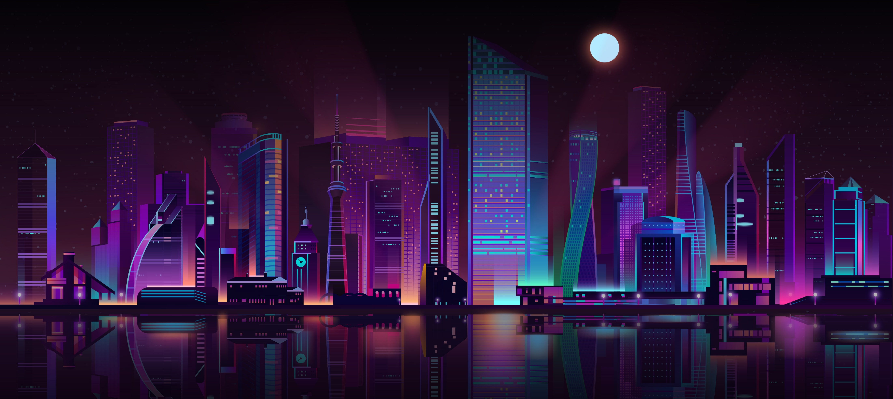
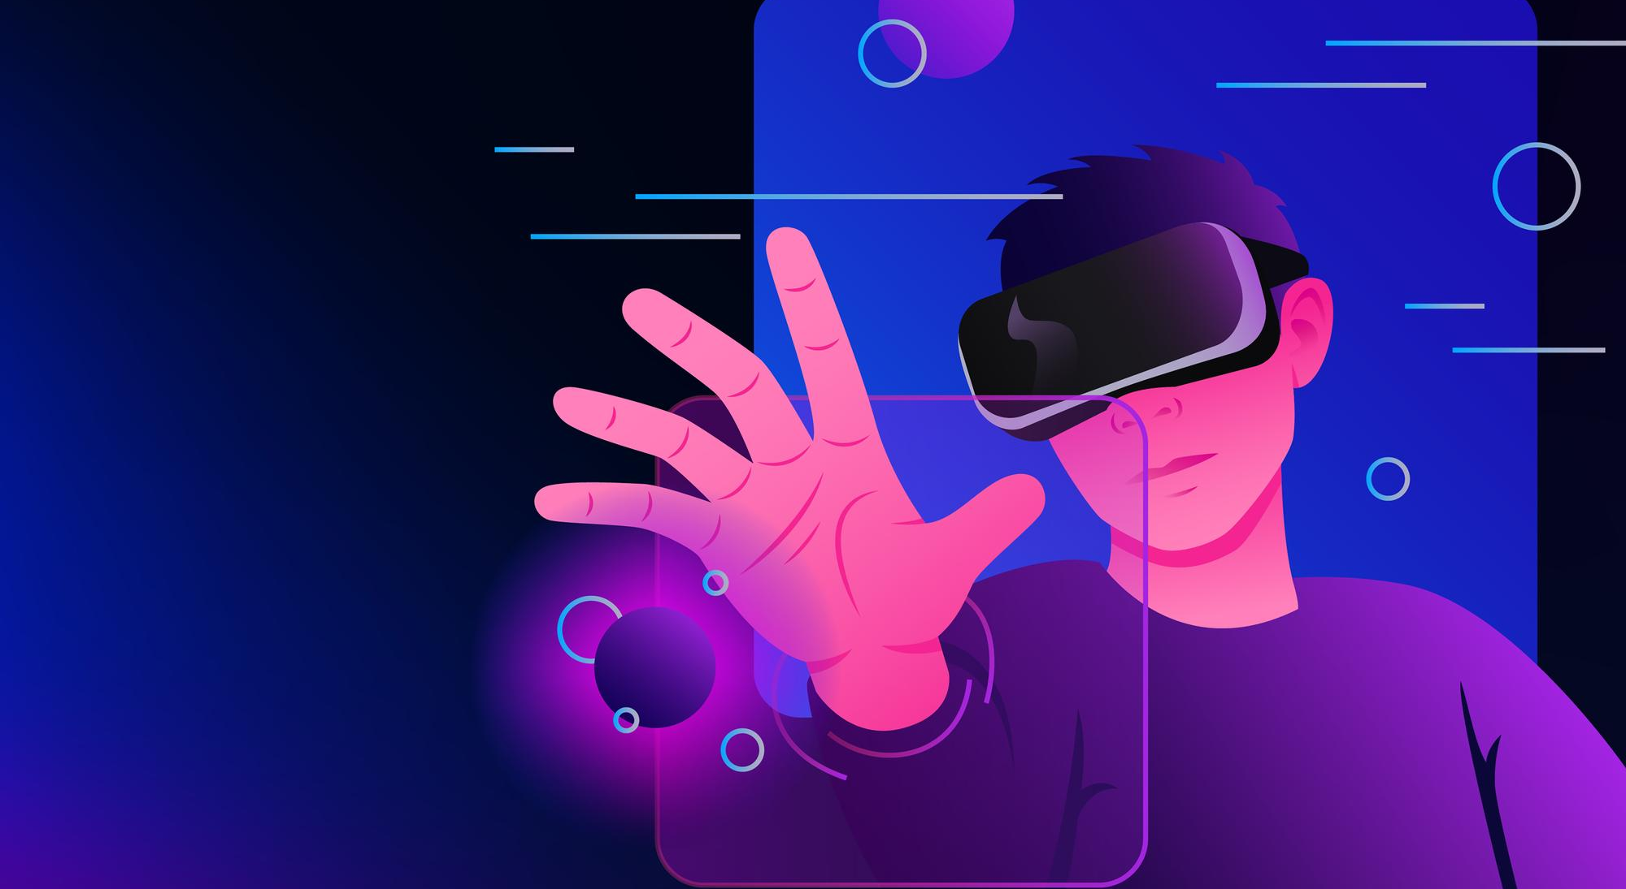
What is Metaverse?
The metaverse is a concept of a persistent, online, 3D universe that combines multiple different virtual spaces. You can think of it as a future iteration of the internet. The metaverse will allow users to work, meet, game, and socialize together in these 3D spaces.
The metaverse will be driven by augmented reality, with each user controlling a character or avatar. For example, you might take a mixed reality meeting with an Oculus VR headset in your virtual office, finish work and relax in a Blockchain-based game, and then manage your crypto profile and finances all inside the metaverse.
Something To Know
The concept was developed in the science-fiction novel Snow Crash by Neal Stephenson. However, while the idea of a metaverse was once fiction, it now looks like it could be a reality in the future.

Slide 5
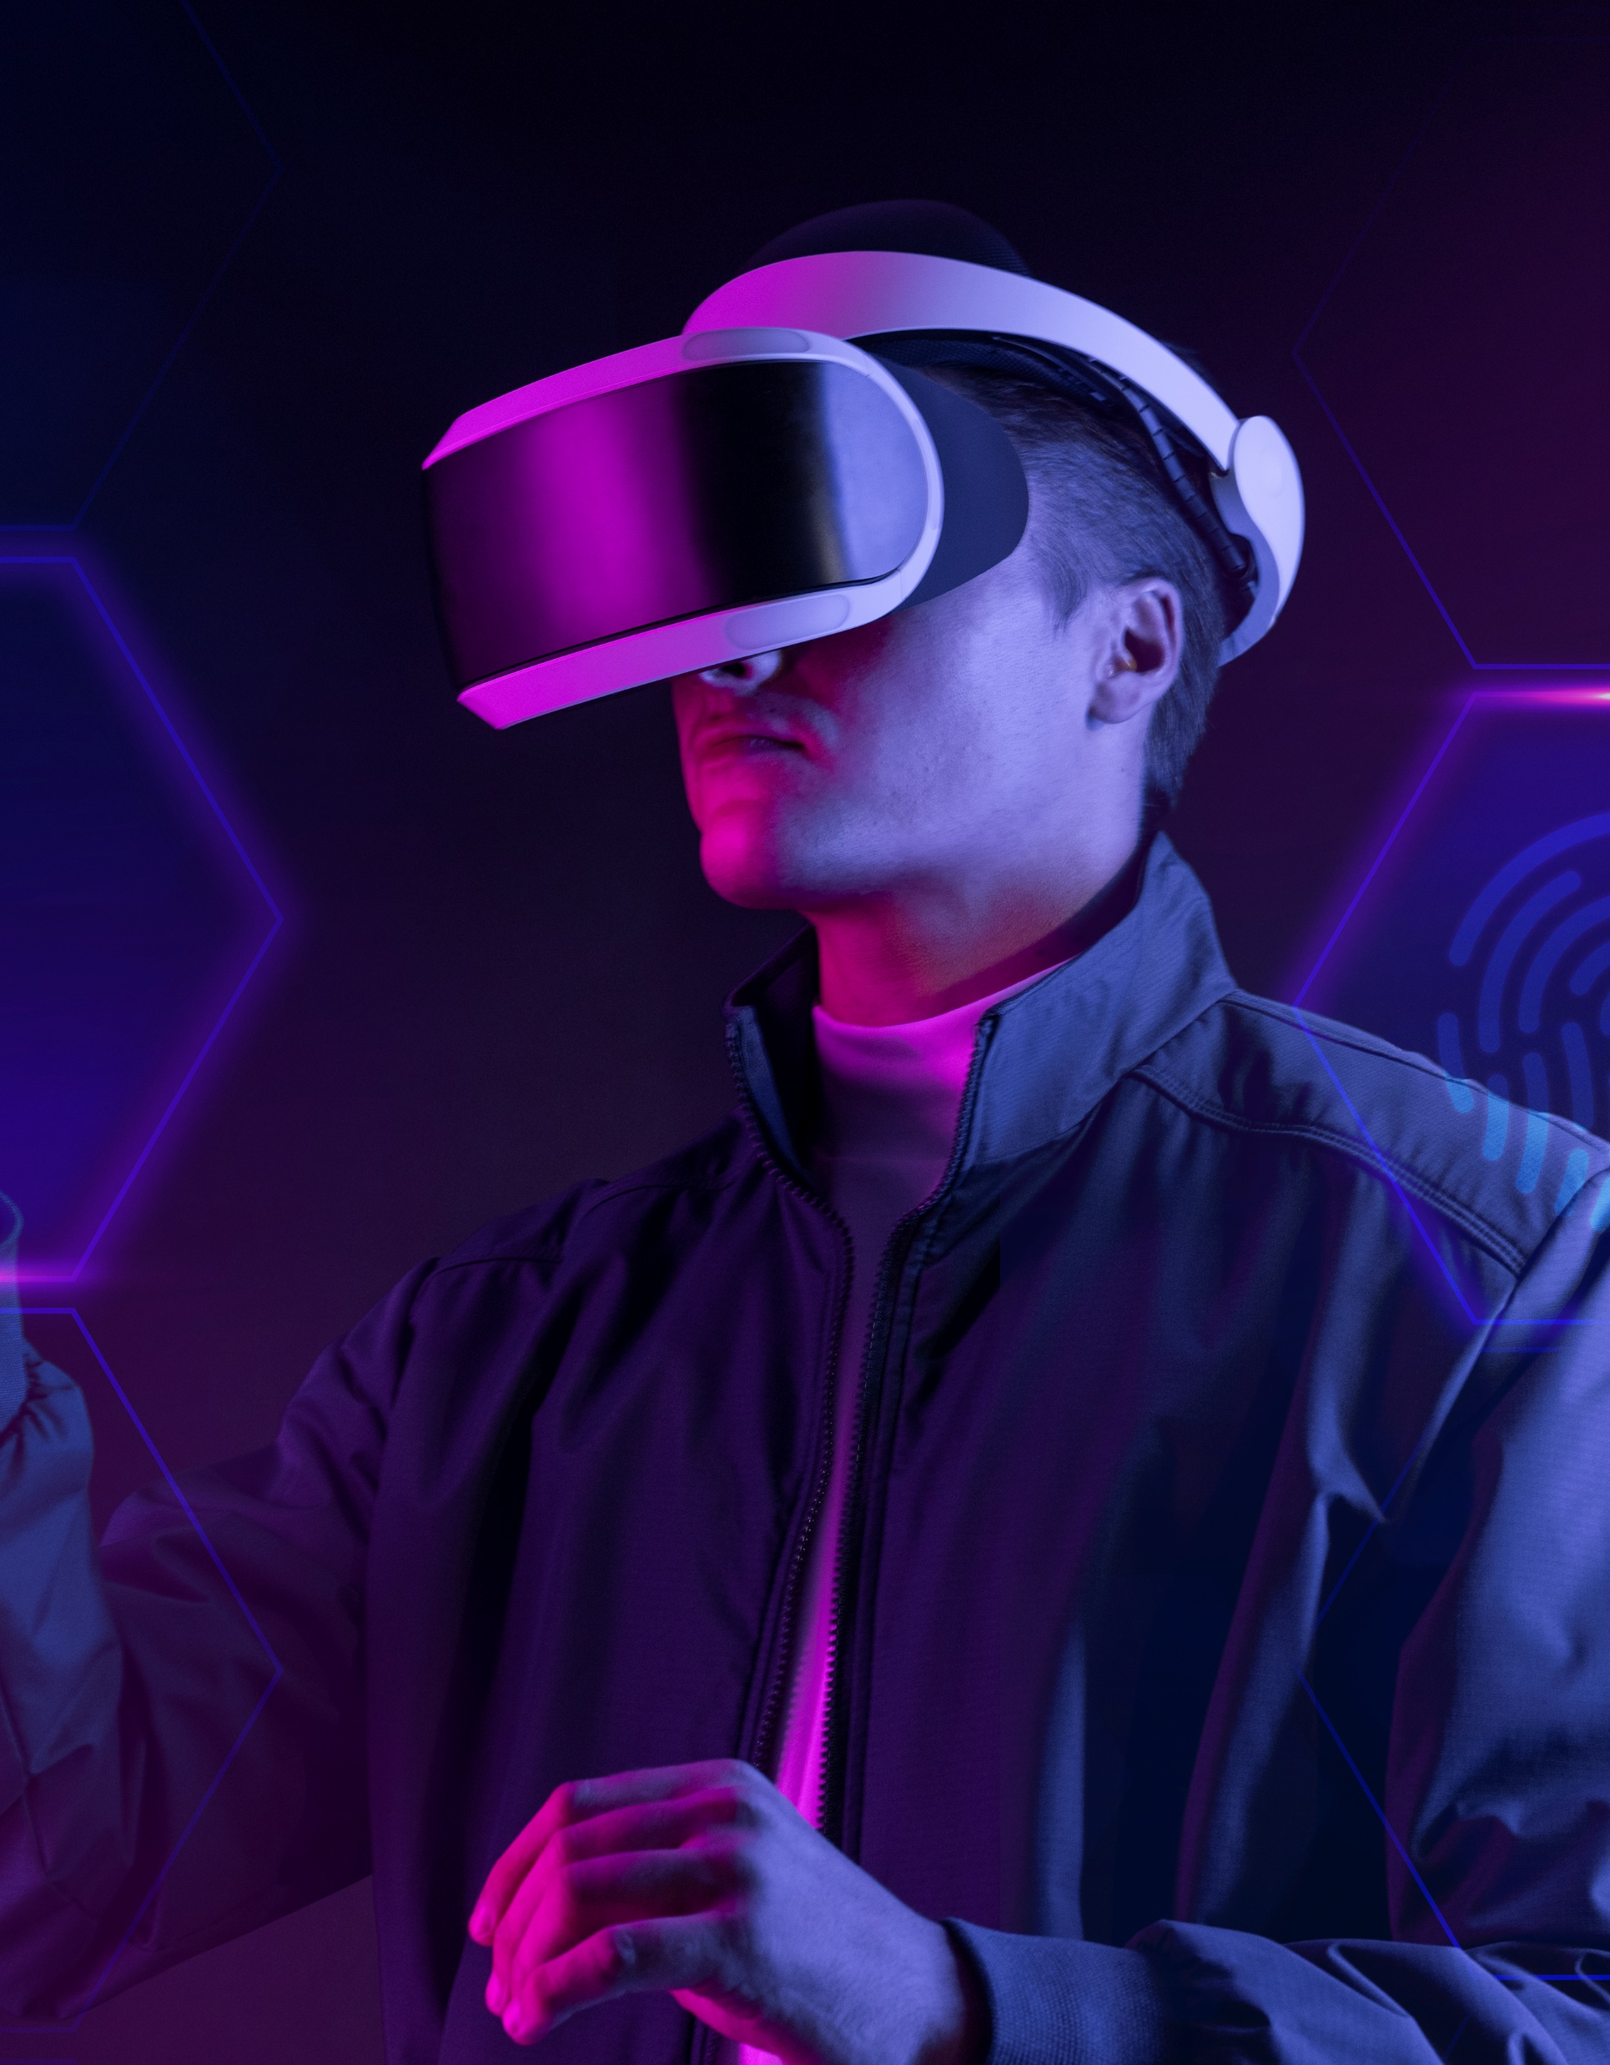
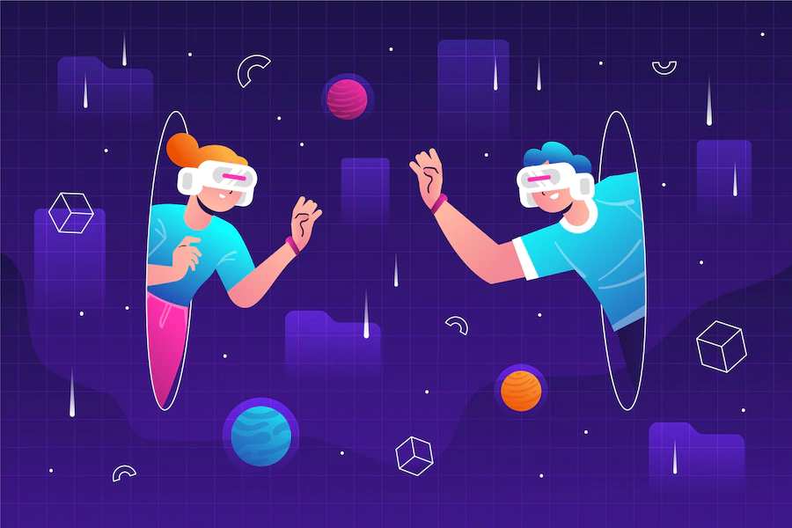
What is Metaverse?
To see the metaverse in action, we can look at popular massively multiplayer virtual reality games where participants use avatars to interact with each other and manipulate their environment.
But the wider applications beyond gaming are staggering. Musicians and entertainment labels are experimenting with hosting concerts in the metaverse. The sports industry is following suit, with top franchises like Manchester City building virtual stadiums so fans can watch games and, presumably, purchase virtual merchandise.
perhaps the farthest-reaching opportunities for the metaverse
will be in online government services.
The metaverse contains exciting new applications for education at all levels.

Slide 6
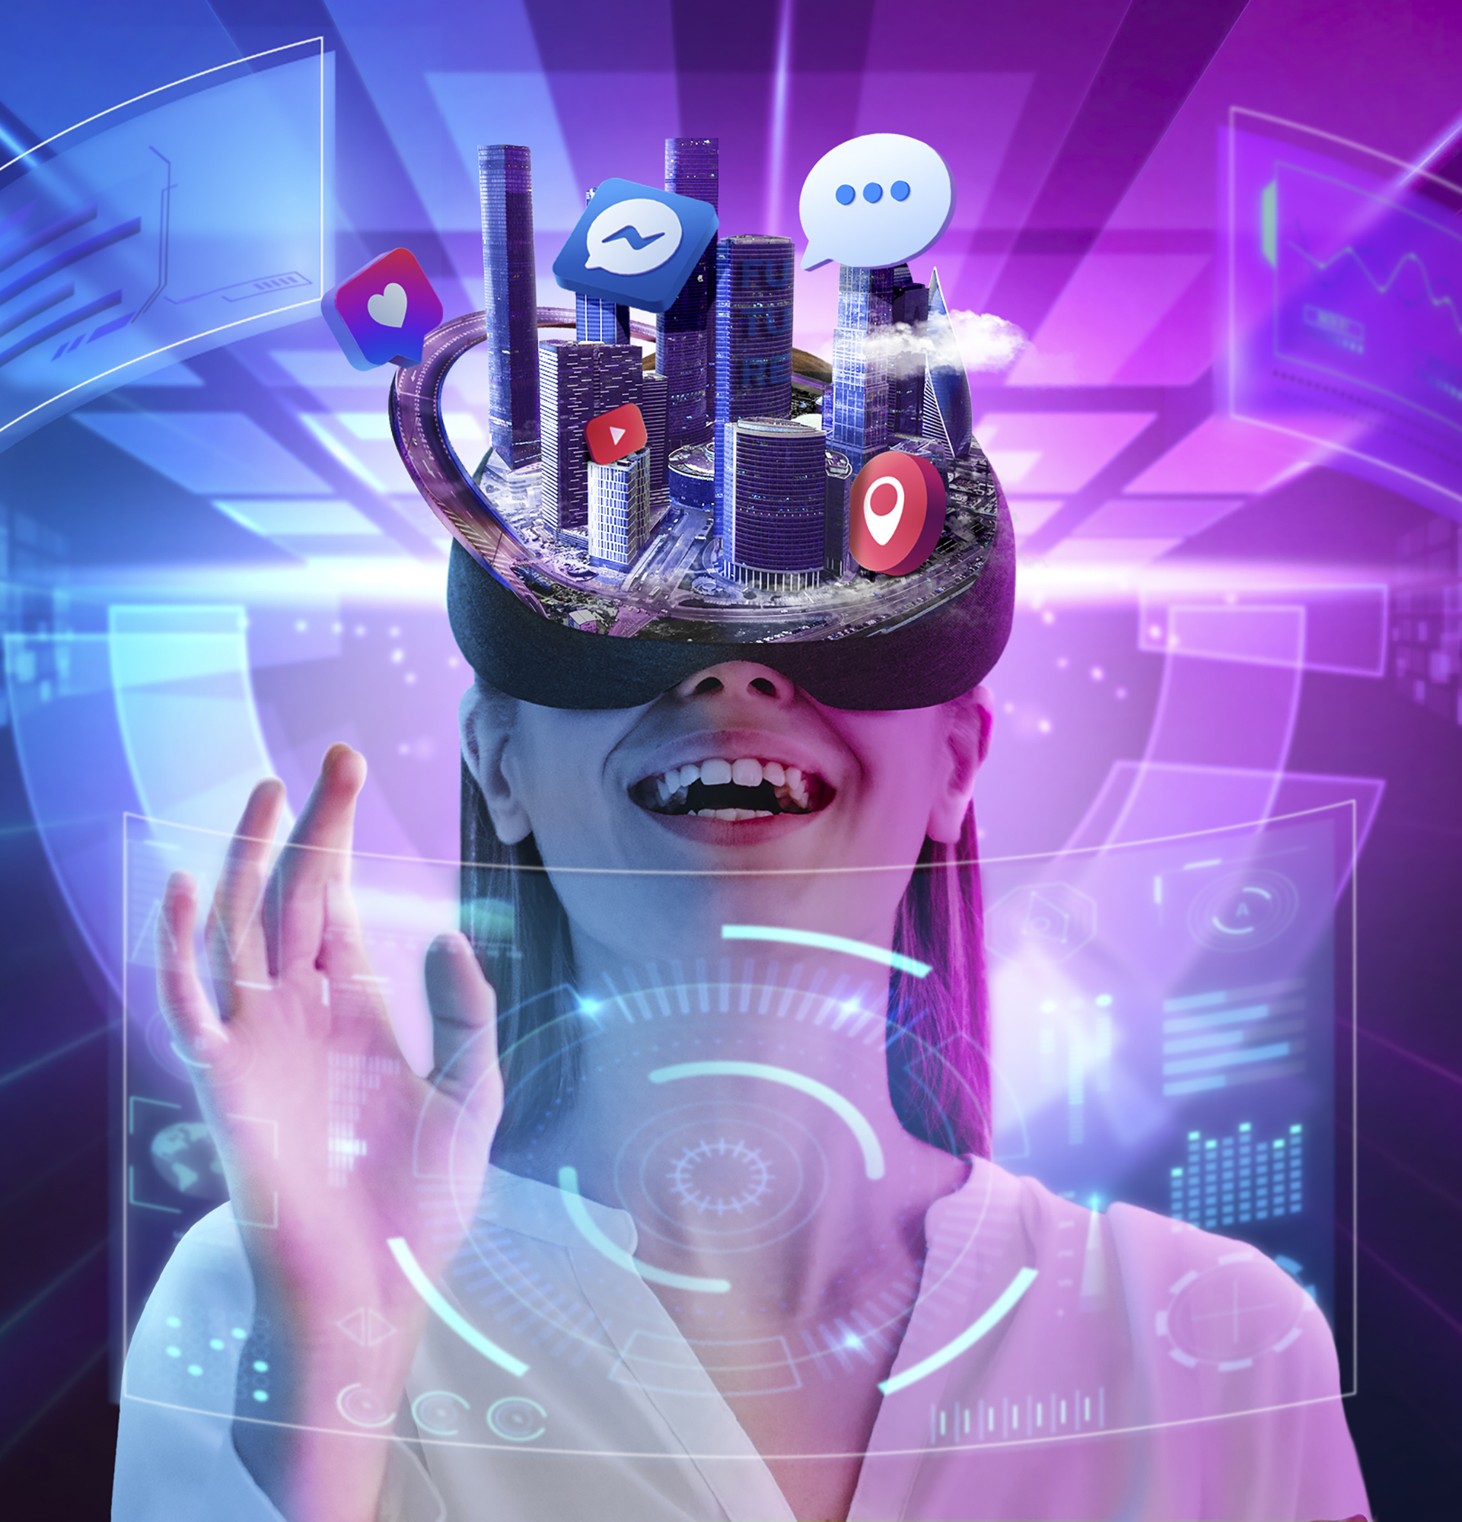
What Actually We Do In Metaverse?
There are things you can do in virtual reality and augmented reality that you just can’t do in real life across distance. You can mimic being together in ways that aren’t possible over Zoom. You can point to something to explain, use hand gestures (in some platforms), draw on a piece of paper, go places together.
Think about the incredible possibilities, such as a collaboration between surgeons, or creating a clay model for a new-car design. These and all sorts of other collaborative activities are all easy in the right metaverse world, which eliminates the impediment of distance. “For organizations, a virtual or hybrid meeting feels as close as you can get to being together in a room.
Of course, it’s not the same as in person, but it’s second best. My team is set up to have collaborative meetings this way. And when we need a work break, we have 15-minute one-on-one get togethers to play virtual ping pong with colleagues from all over the world. It’s the virtual equivalent of an office coffee break; it creates a real connection and builds social bonds.”

Slide 7
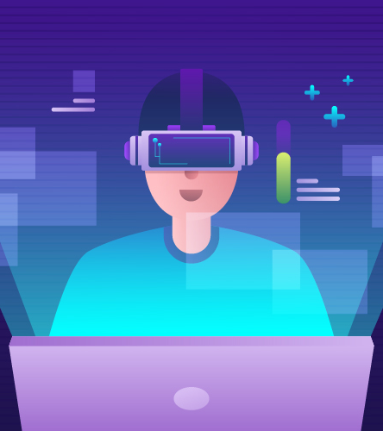
Metaverse Strategy
This is the popular conception of the metaverse: a VR-based world independent of our physical one where people can socialize and engage in a seemingly unlimited variety of virtual experiences, all supported with its own digital economy.
You can already see some aspects of the metaverse in existing virtual video game worlds. Games like Second Life and Fortnite or work socialization tools like Gather. town bring together multiple elements of our lives into online worlds. While these applications are not the metaverse, they are somewhat similar. The metaverse still doesn’t exist yet.
Besides supporting gaming or social media, the metaverse will combine economies, digital identity, decentralized governance, and other applications. Even today, user creation and ownership of valuable items and currencies help develop a single, united metaverse. All these features provide blockchain the potential to power this future technology.

Slide 8
Reference
https://bernardmarr.com/
https://academy.binance.com/
https://www.forbes.com/
BOOK (The Metaverse And How It Will Revolutionize Everything )

Slide 9

Thank You.

